Slide 1
EARTH PROTECTORS
Providing ideas for Eco Learning in our School

Slide 2
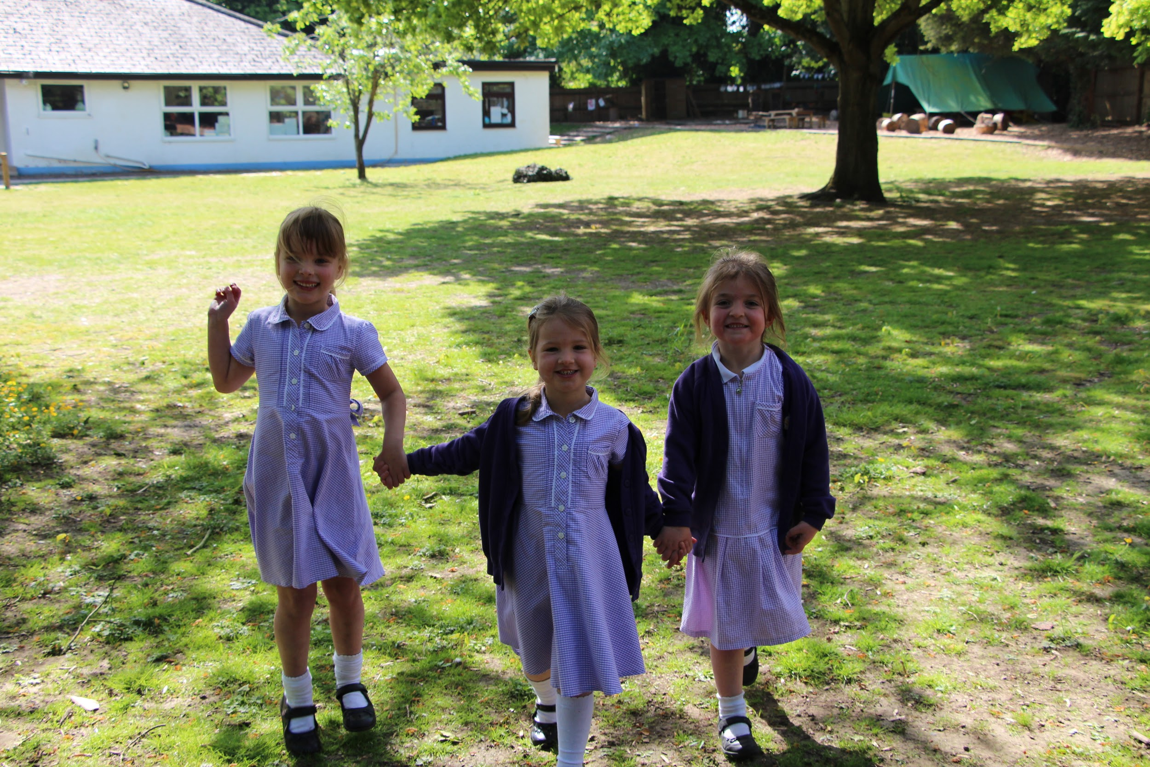
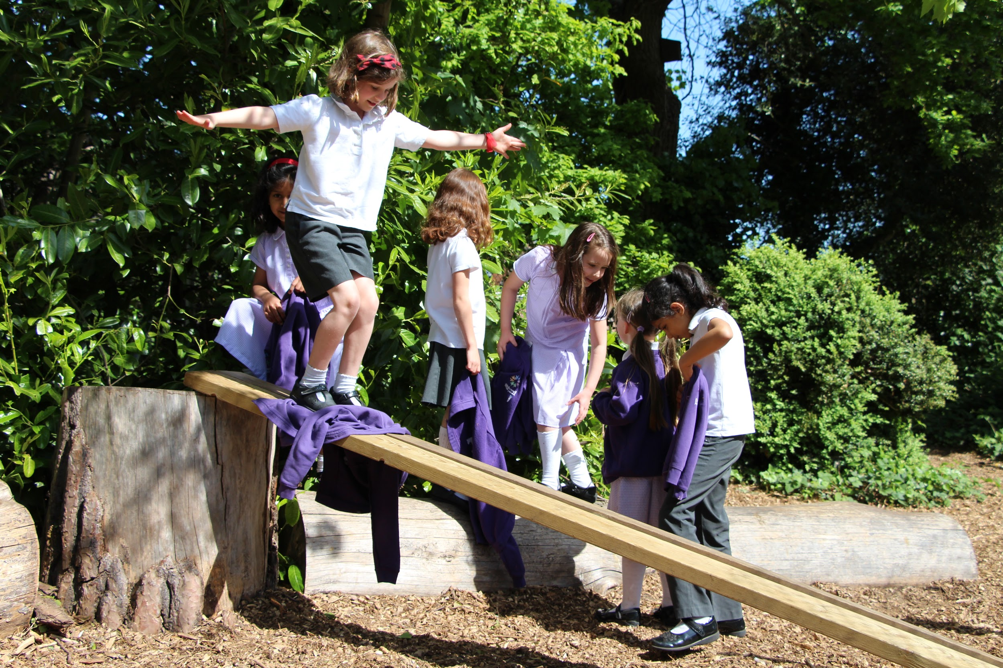
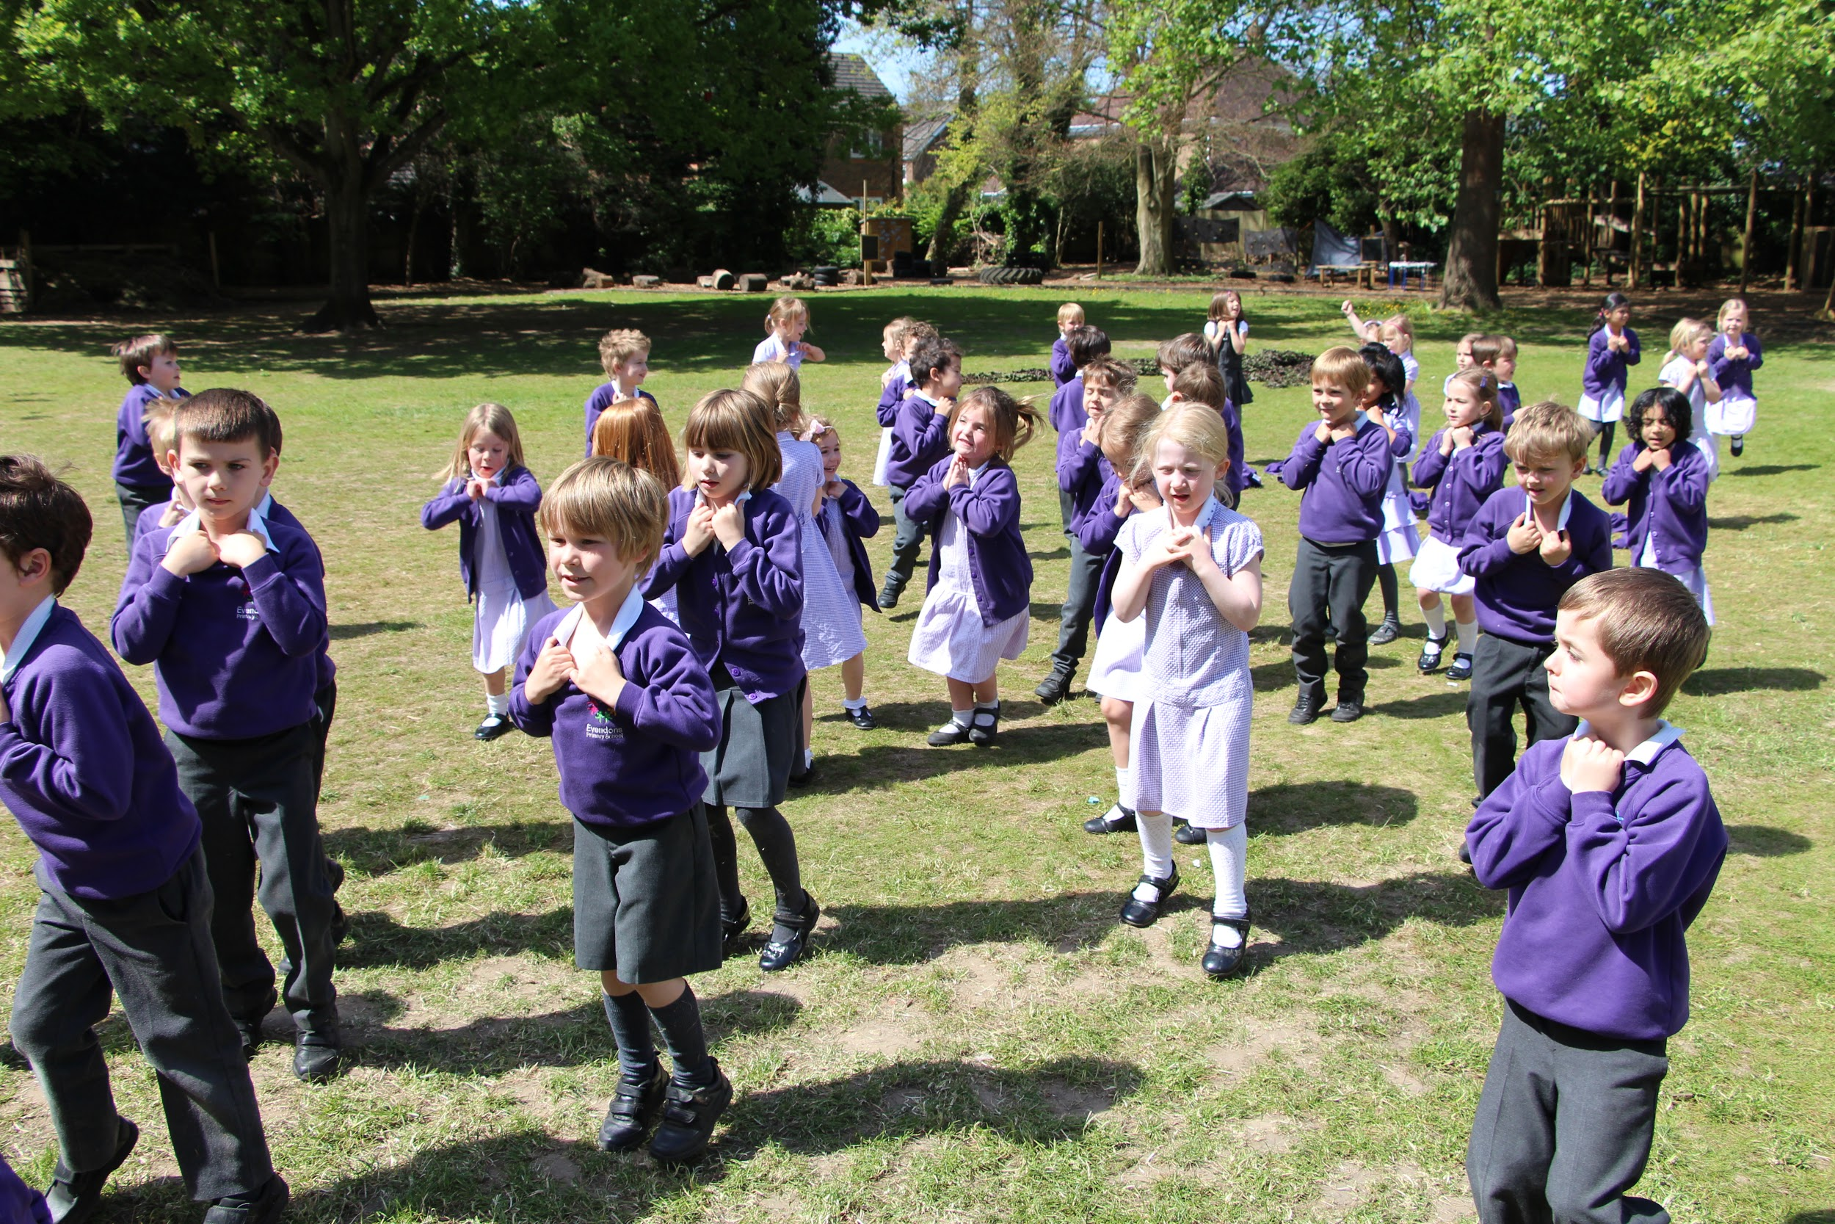
Evendons Primary School
Who are we?

Slide 3
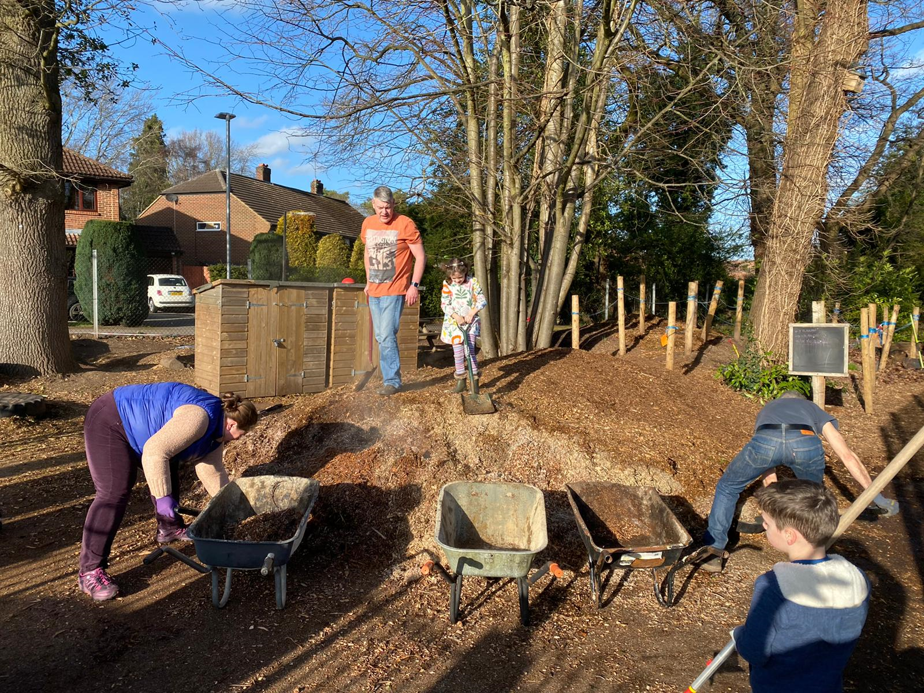
WHOLE SCHOOL APPROACH
Looking After the School Grounds
The school is fortunate to have lovely school grounds with lots of trees. The children and their families help maintain the school environment in money ‘work parties’.
The trees and branches that come down are turned into woodchip and then used to form the paths around the school
Children help play new trees and shrubs to maintain the environment
Children respect the paths ways and leave areas for the wildlife to grow and live.

Slide 4
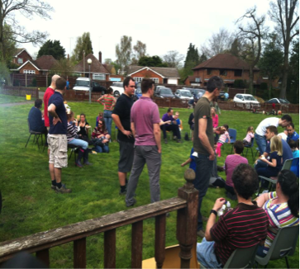
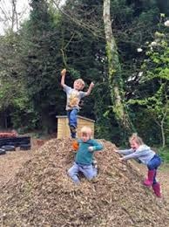
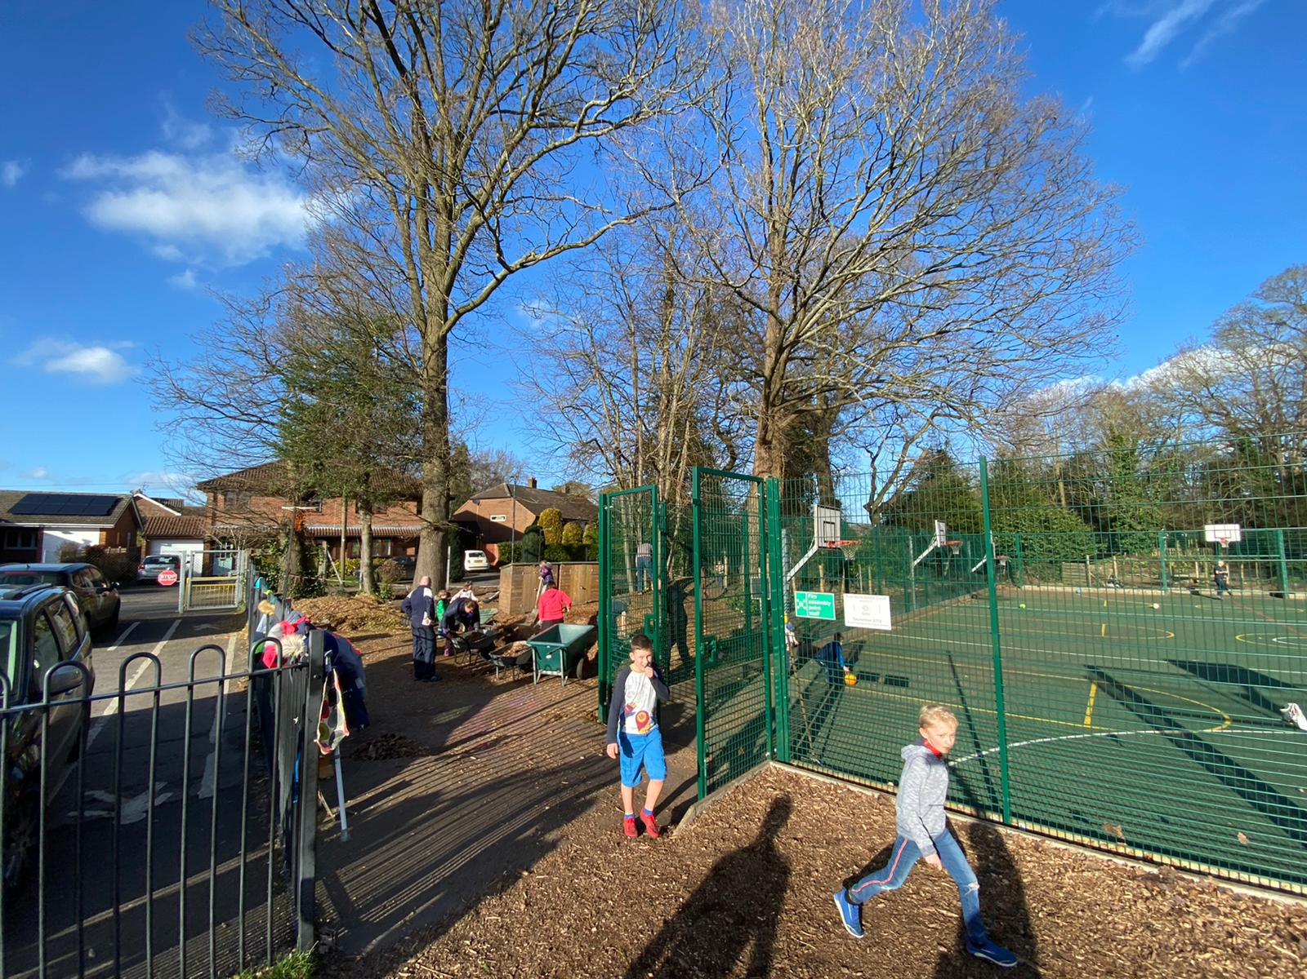
WHOLE SCHOOL APPROACH
WORK PARTIES
Children arrive with parents on a saturday afternoon, once a term.
They create wood chip paths,
Teaches the children to respect the grounds

Slide 5
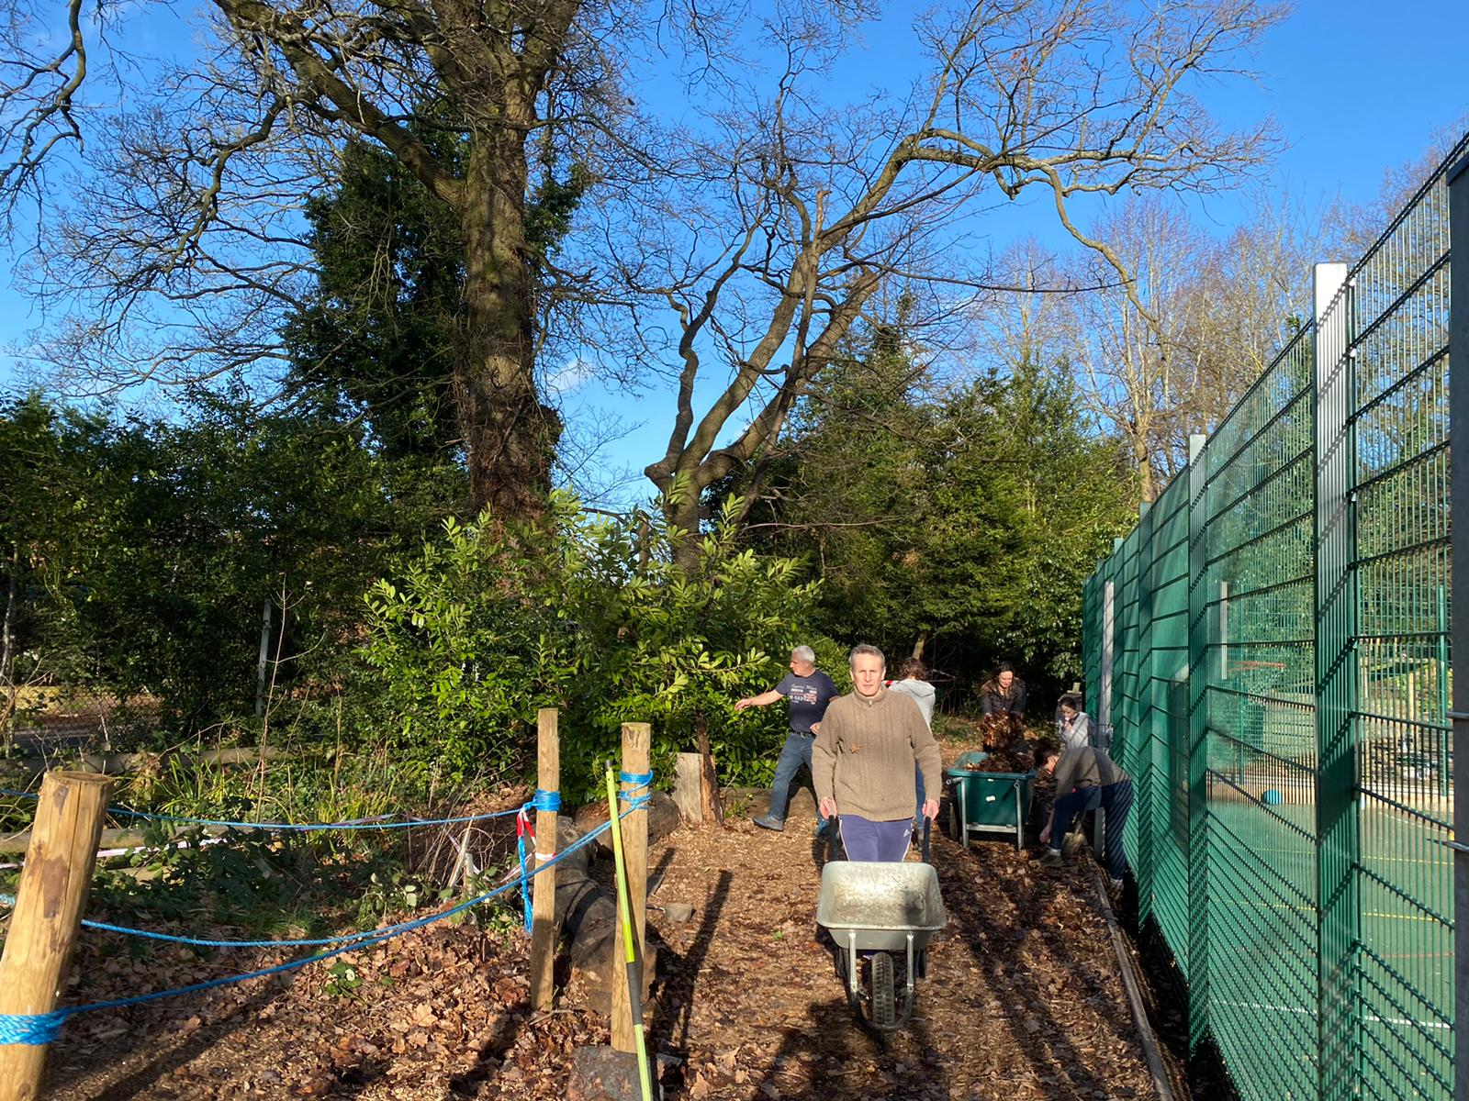
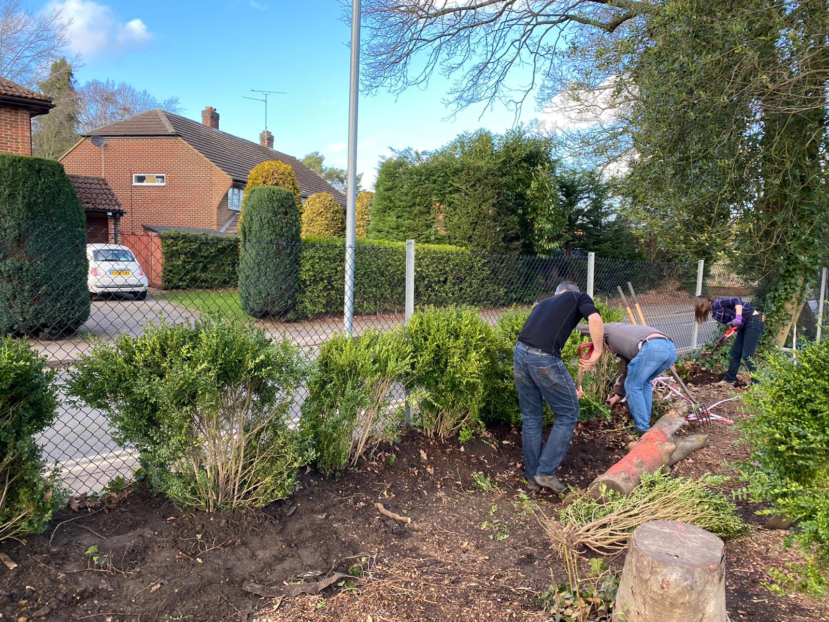

Slide 6
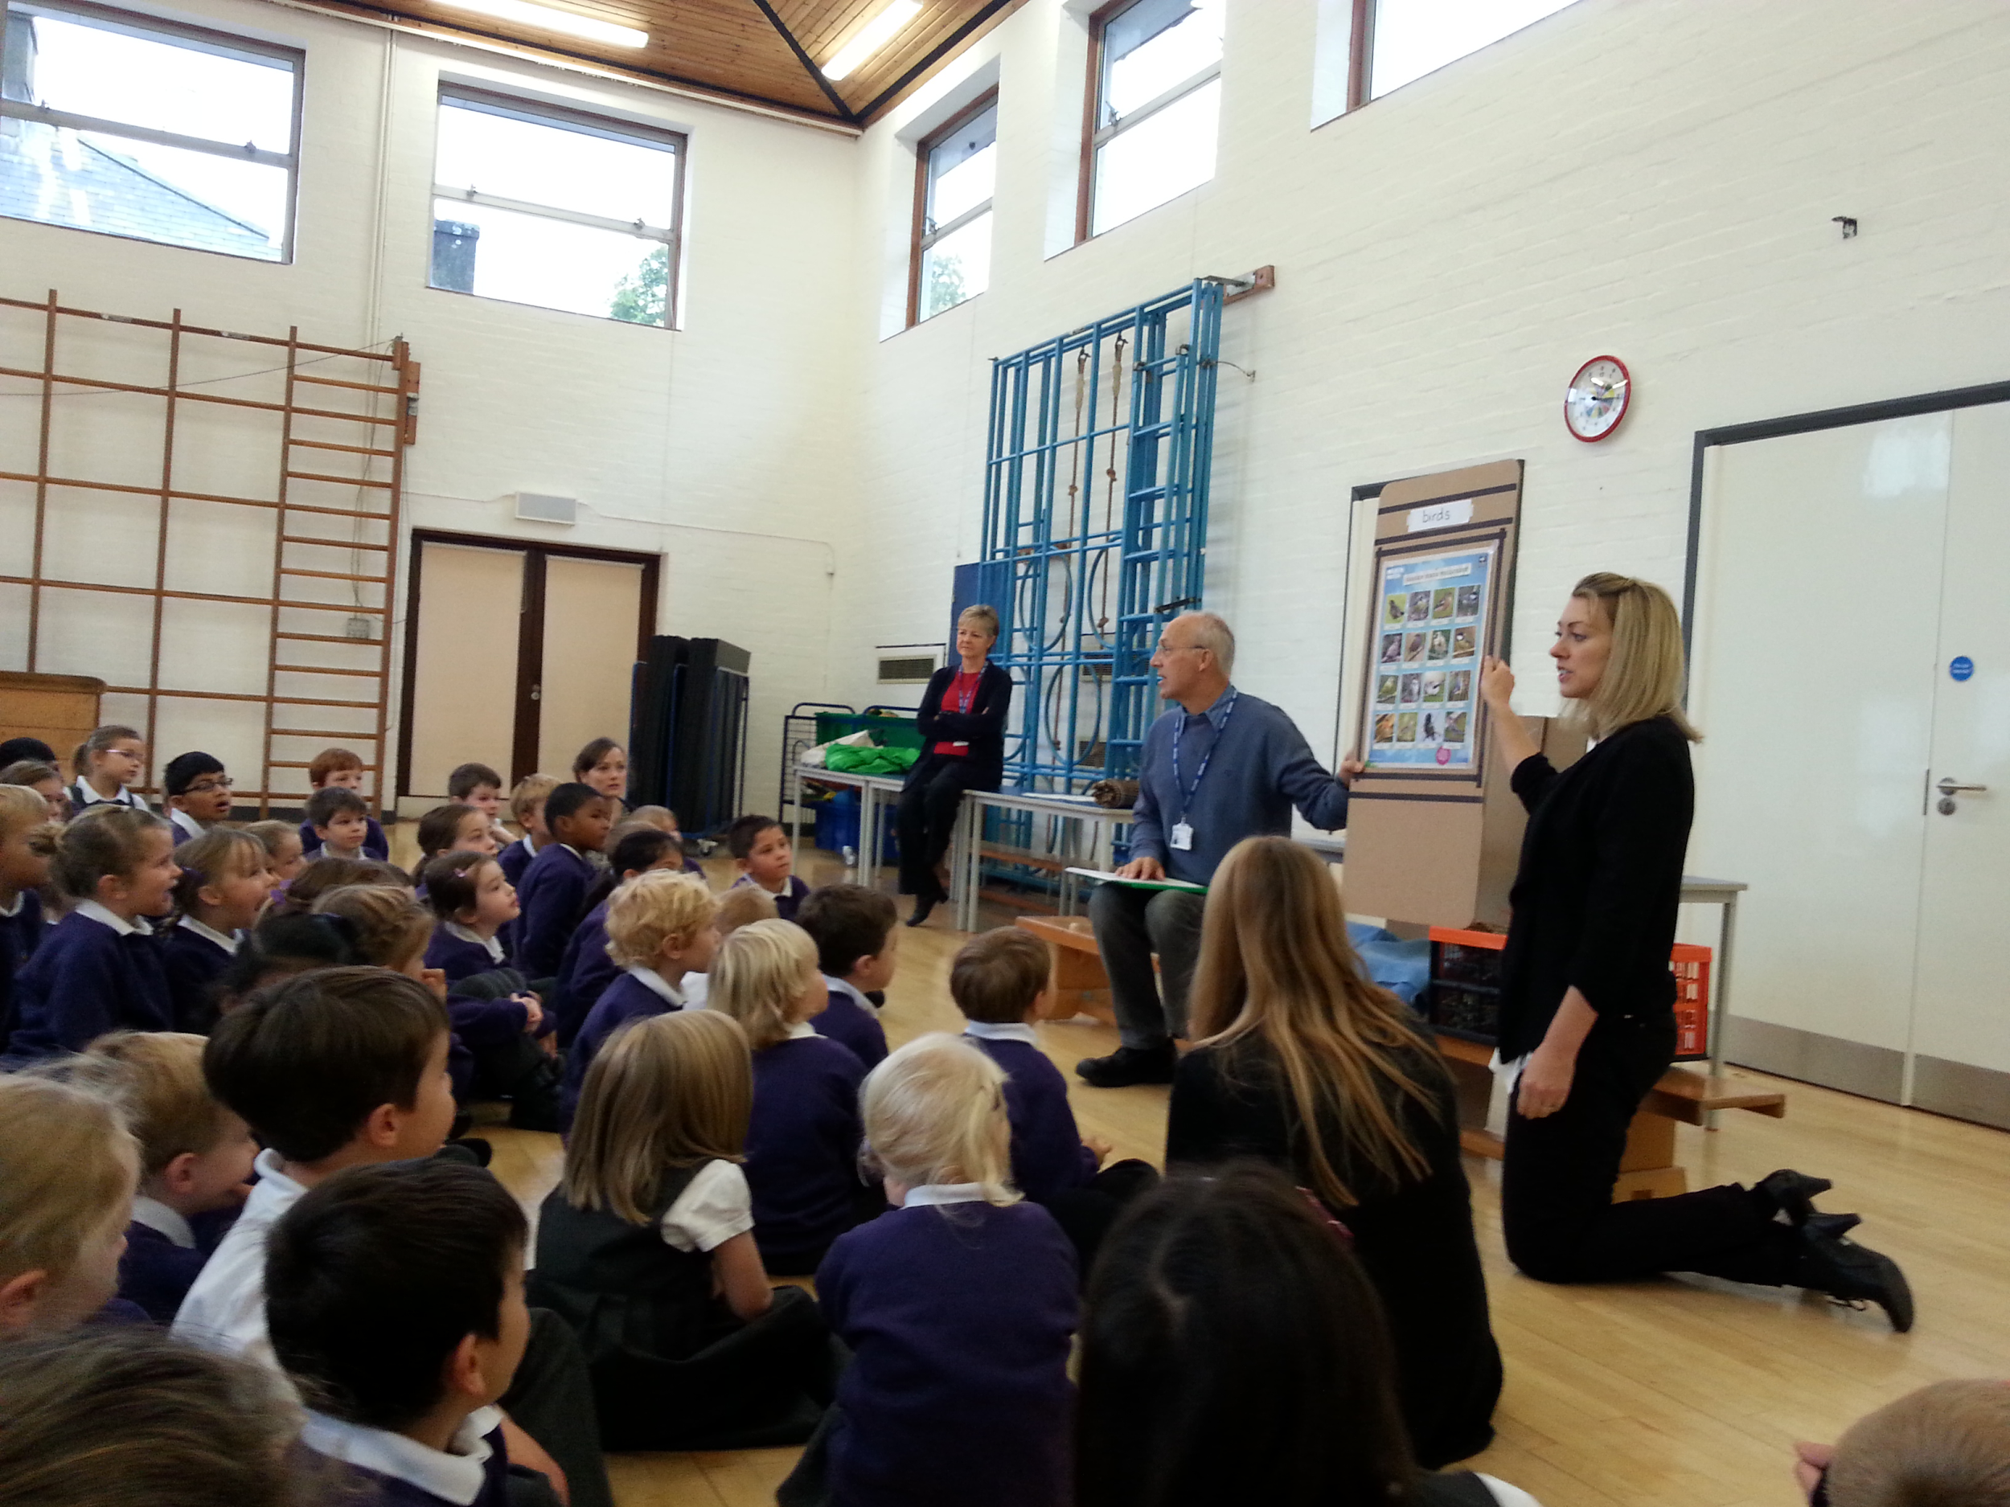
WHOLE SCHOOL APPROACH
PLASTIC PLEDGE
The whole school made a pledge to stop using single use plastic bottles and to use reusable bottles instead. There has been a significant reductions of single use plastic bottles in school as a result. The children created a display in the hall to remind us all to stop using plastic,

Slide 7
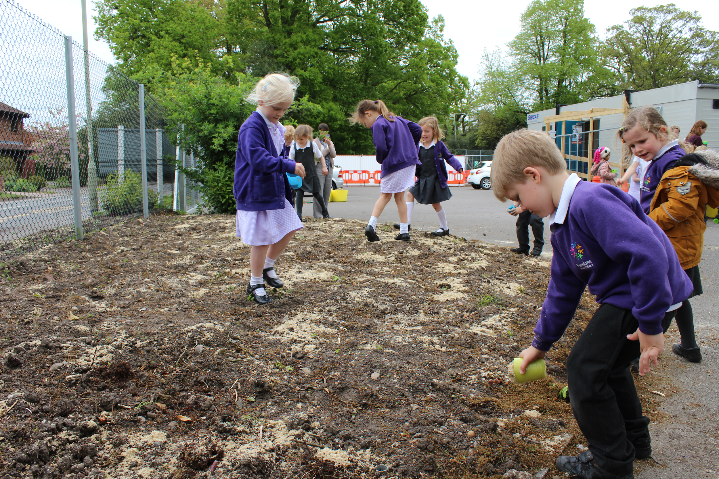
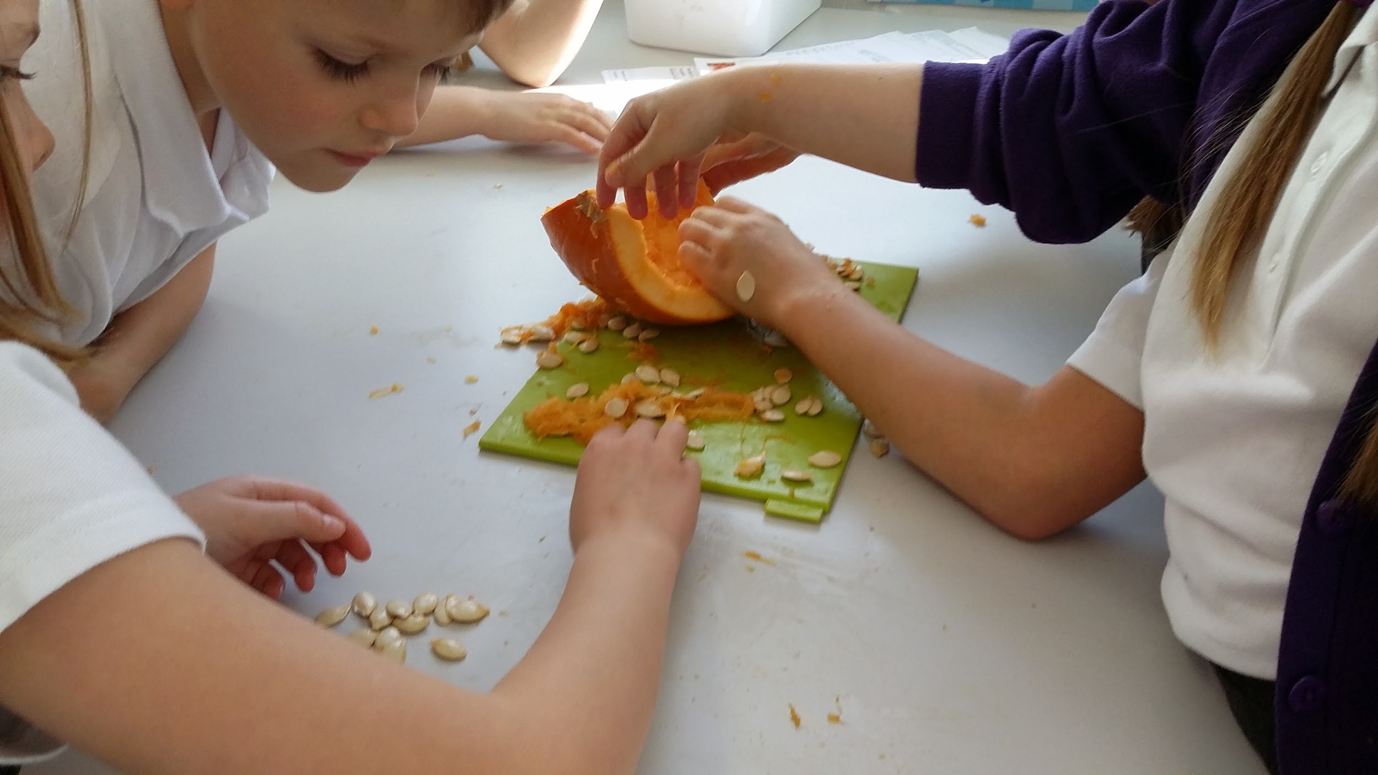
WHOLE SCHOOL APPROACH
Growing Vegetables
Each year children grow vegetables and use these to cook. This is teaching children where food comes from and encouraging them to grow their own food and eat food that is seasonal rather than flown in from around the world.
There is a pumpkin day once a year, where we harvest the pumpkins. The children learn about the story Pumpkin Soup by and make their own soup - making soup throughout the day.

Slide 8
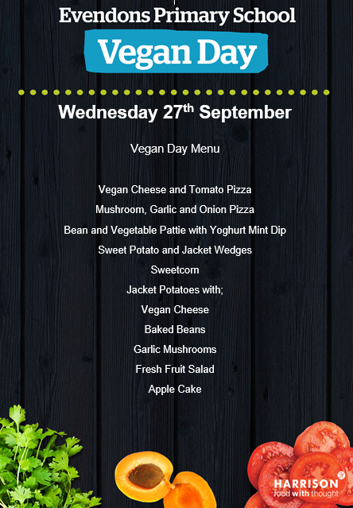
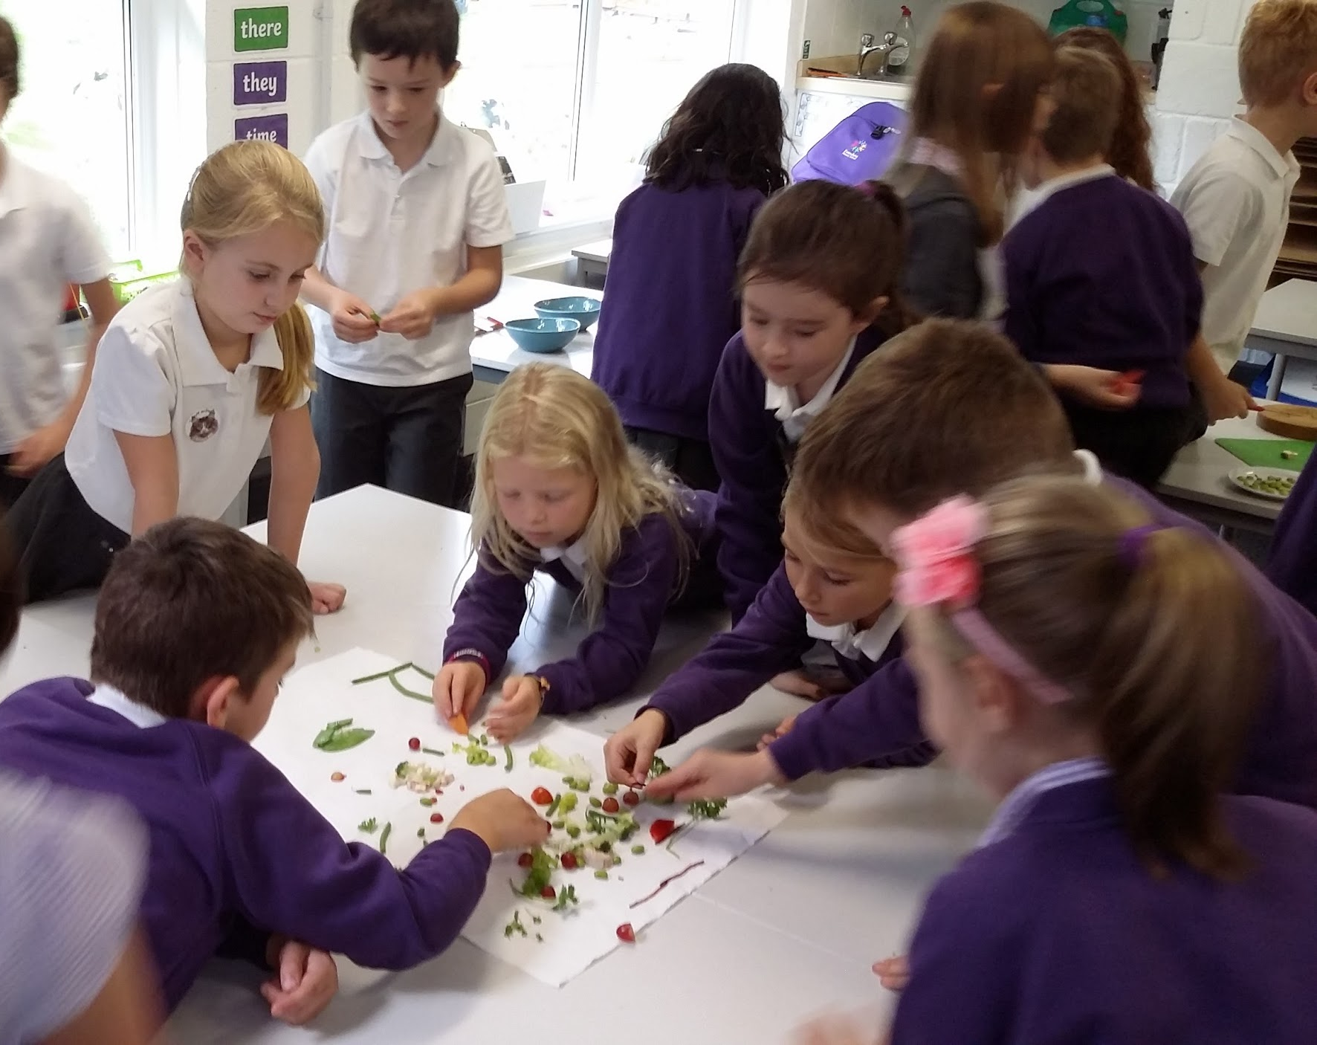
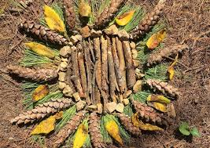
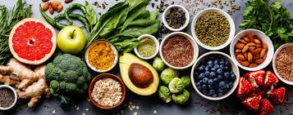
WHOLE SCHOOL- Vegan Day
Vegan day. The whole school learnt about being a vegan, they made vegan wraps and smoothies and tried vegan food. They identified everyday objects which were made using animal products. The children debated different vegan issues and could clearly back up their beliefs and understanding. We had a storyteller. The children explored artwork by Andy Goldsworthy, using natural materials to create pictures. Children smelt and tasted a wide range of vegetables. Animal aid came and spoke to the children.

Slide 9
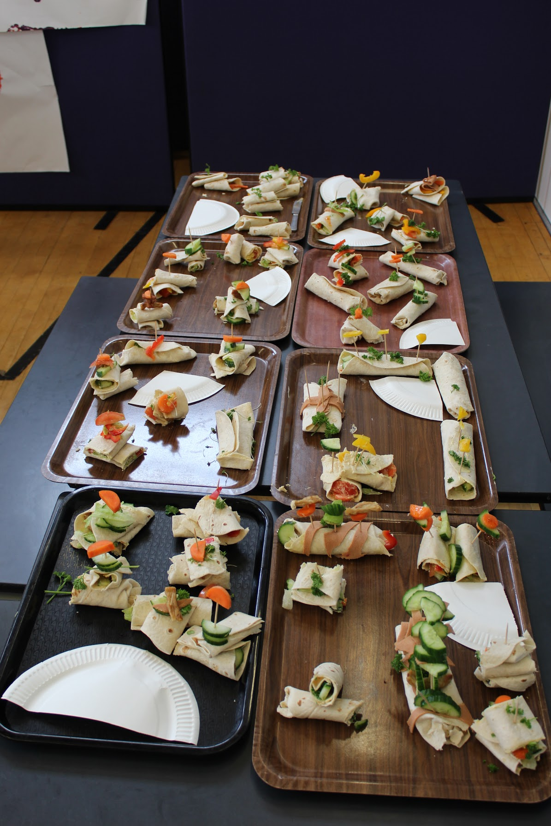
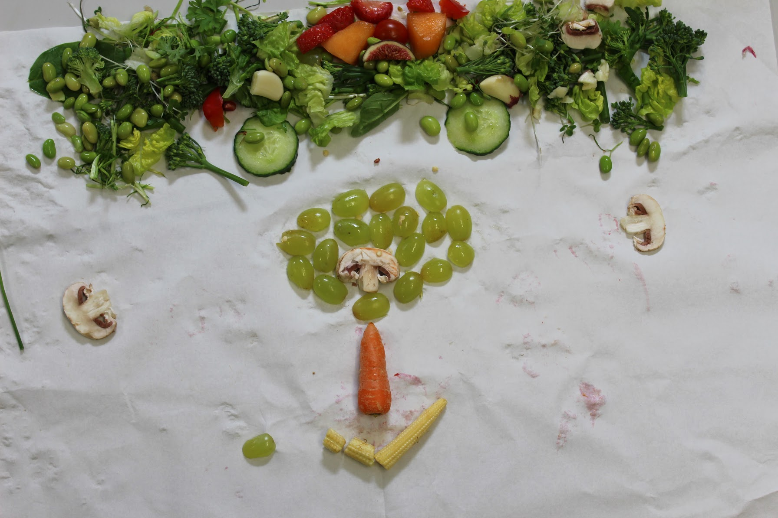
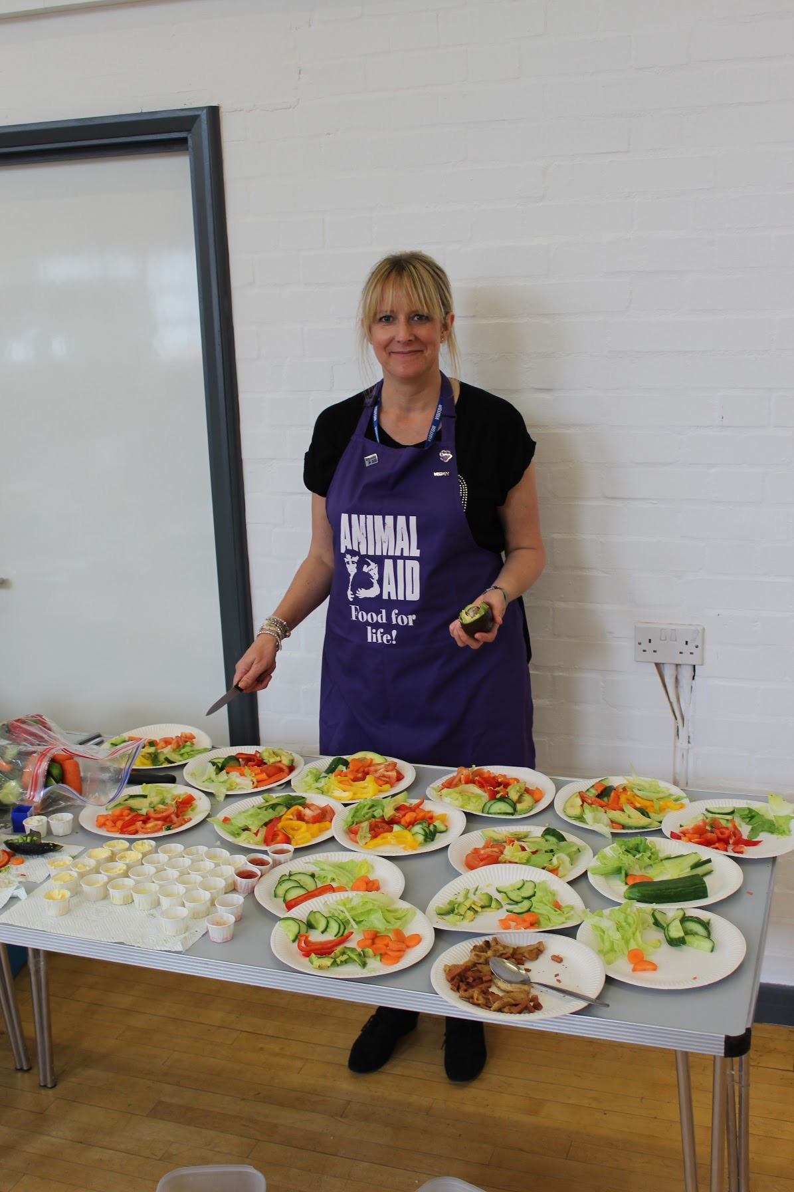
Vegan Day Photos

Slide 10
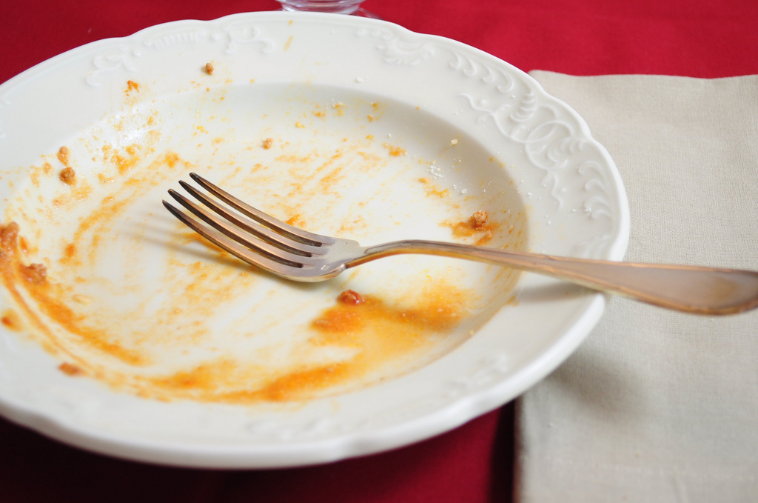
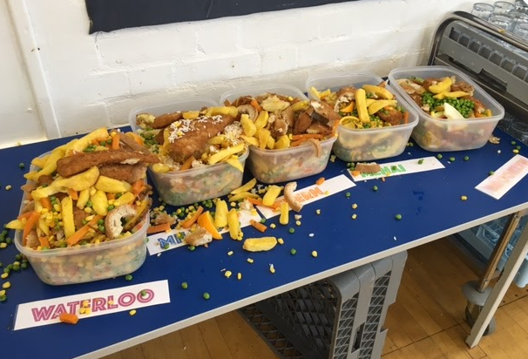
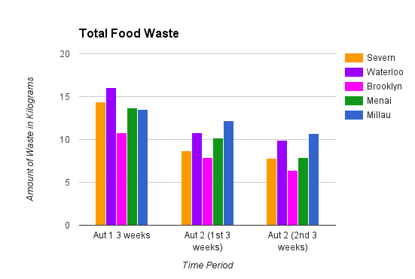
WHOLE SCHOOL APPROACH
Waste food

Slide 11
Whole School Approach
Big battery hunt
Children learnt that recycling batteries means keeping dangerous chemicals out of the ground. They also discovered that the recycled materials could be used to make many new products.
The response was fantastic. So many children spread the word and collected batteries from friends and neighbours.
We were able to link this project to several of the UN sustainable development goals.

Slide 12
WHOLE SCHOOL APPROACH
TRIPS
Tescos - fair trade workshop
Living rainforest
Gilbert White’s house
VISITORS
Antarctica Traveller Sandra Pullen
Sustainability shop owner
Local council food waste program

Slide 13
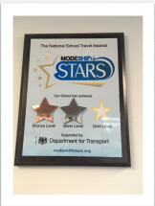
WHOLE SCHOOL APPROACH
Travelling to school
In assembly this morning, Evendons were presented with the silver MODESFIFT star certificate and Silver Star for all the work we have achieved in promoting sustainable travel at school. We are now going for gold.

Slide 14
Curriculum topics
During our Character education lessons children learn about respecting the environment and about the UN sustainable development goals.
Each class has chosen a goal to work on during the year.
Our assemblies are also linked to these goals as well as looking at current environmental issues such as the Australian bushfires.

Slide 15
Rights Respecting School Council
The Rights Respecting School Council are in charge of helping to promote the UN goals for sustainable development as well as the UNCRC. They have led assemblies and organised fundraising activities to raise awareness of the importance of looking after our Earth. They are very passionate about climate change and sustainability having lots of ideas about how everyone can do a little something to make a change.
They promoted climate action day and decided that every class should have one day without using electricity in their class. They have been thinking about how they can communicate their news in an environmentally friendly way rather than using traditional paper newsletters.

Slide 16
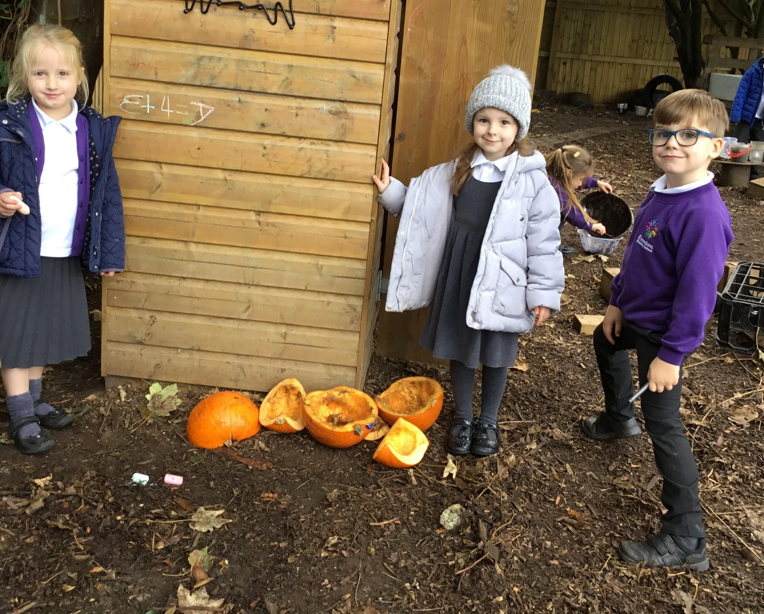
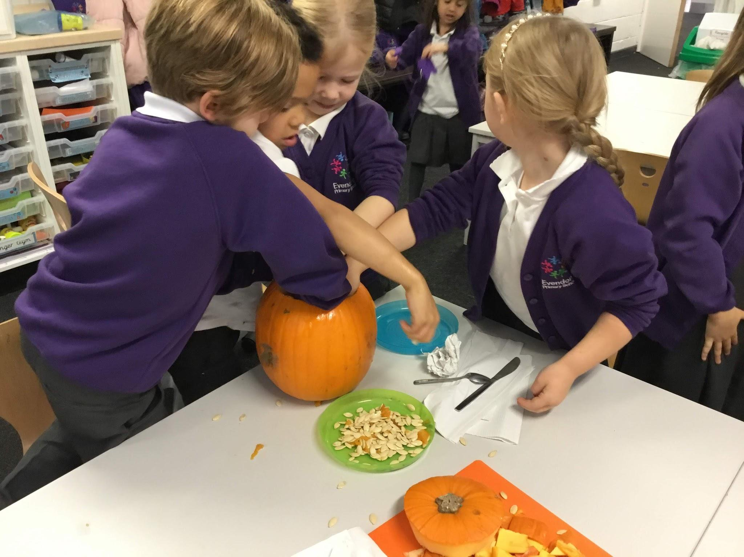
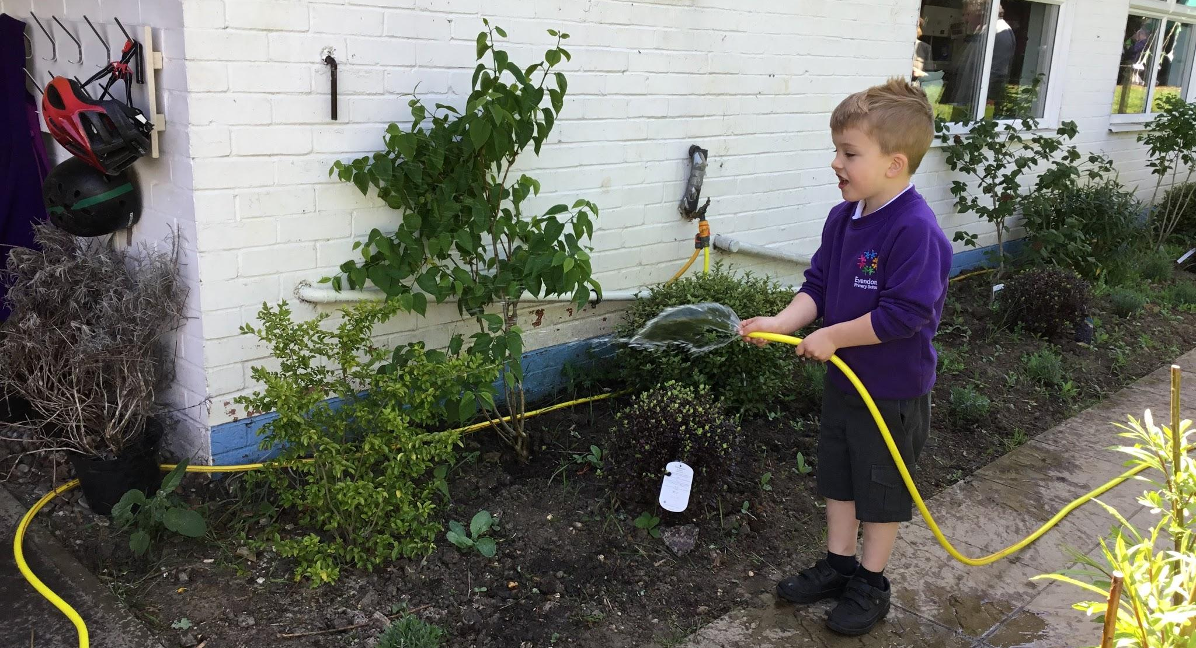
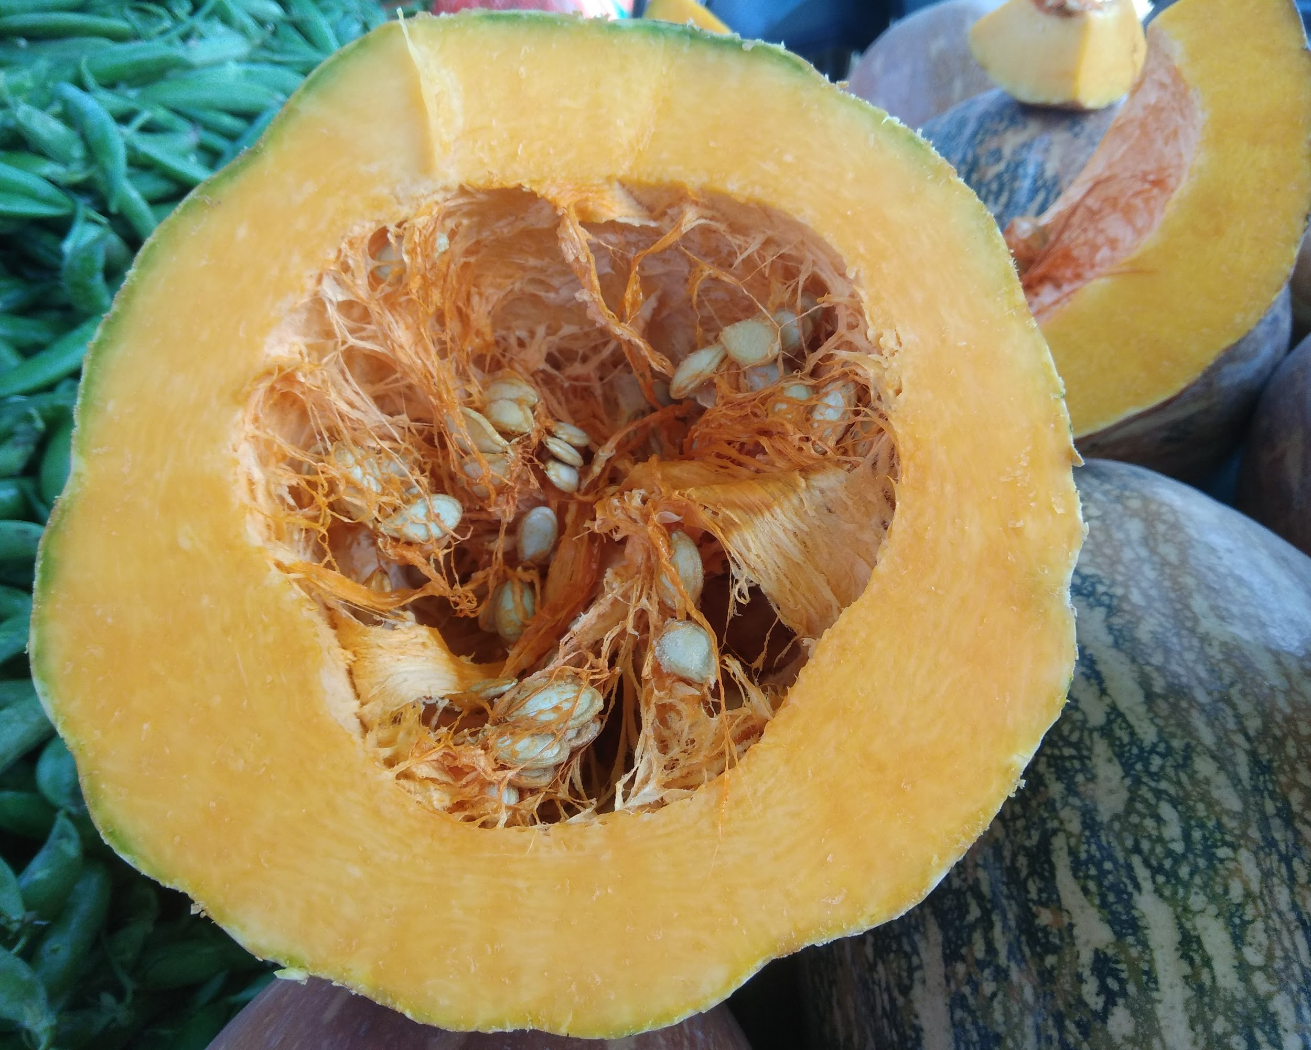
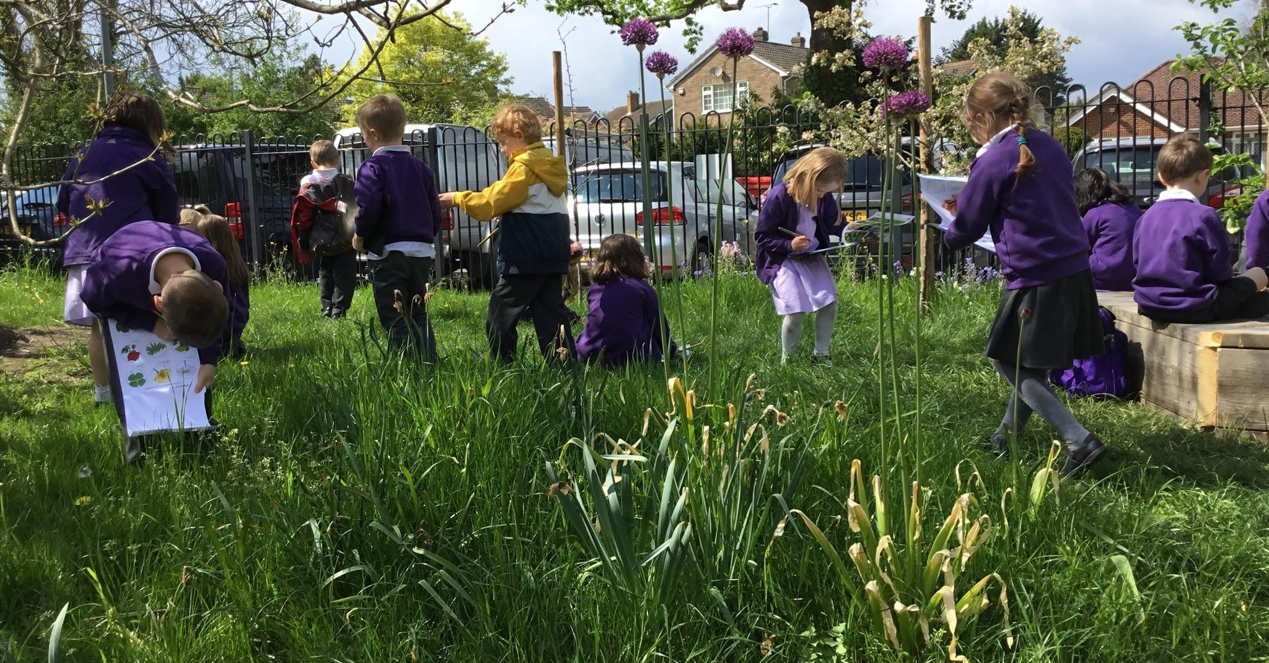
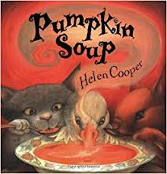
Year 1 Curriculum
In year 1 we use our outdoor space to learn about sustainability and enjoy growing our own plants and vegetables.
In the Autumn term we are able to harvest pumpkins and use them to make pumpkin soup. We use this experience to support the writing of instructions and poetry. After measuring, dissecting and investigating with our pumpkins we ensure they are put in our school compost.
We also grow wild flowers, runner beans, potatoes, tomatoes and strawberries.

Slide 17
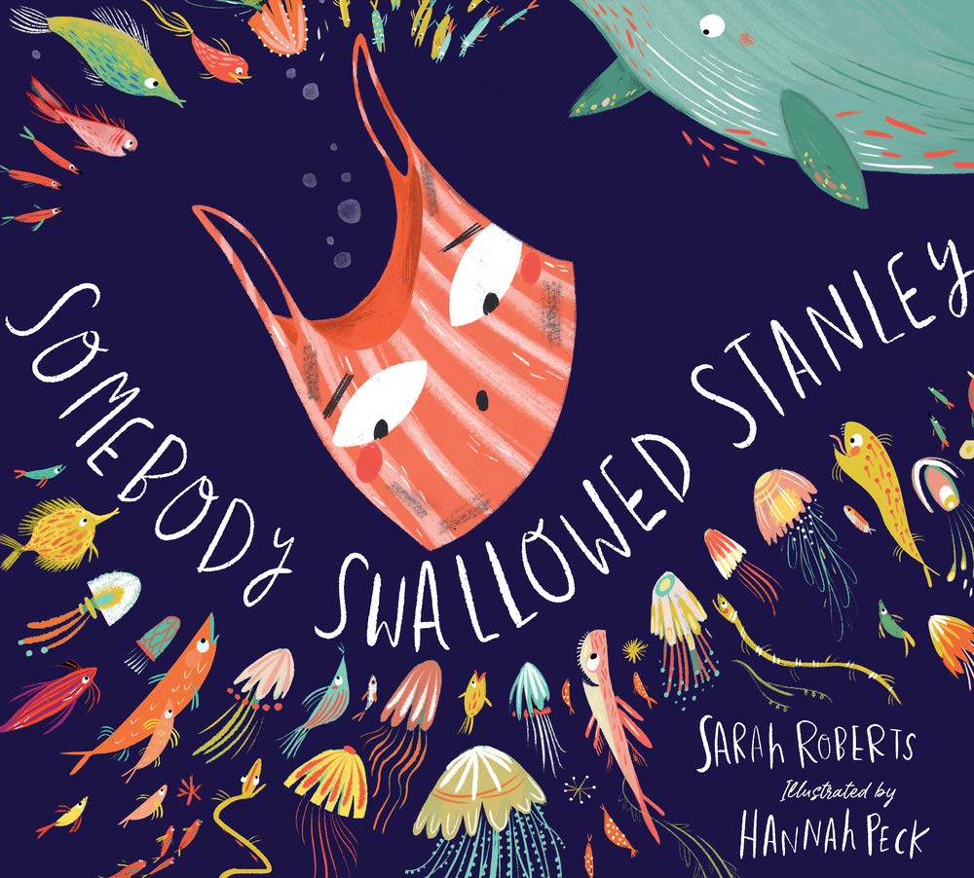
Year 2 Curriculum
As part of Year 2’s topic on Coasts, they explored plastic pollution using the book ‘Somebody Swallowed Stanley’.
The children created Jellyfish sculptures in water by recycling plastic bottles and bags to highlight how much plastic bags look like jellyfish to ocean life.
The classes went out into the local area and did some litter picking and were amazed by the amount of litter they found.
We did the Blue Planet live lesson to learn more about plastic pollution.

Slide 18
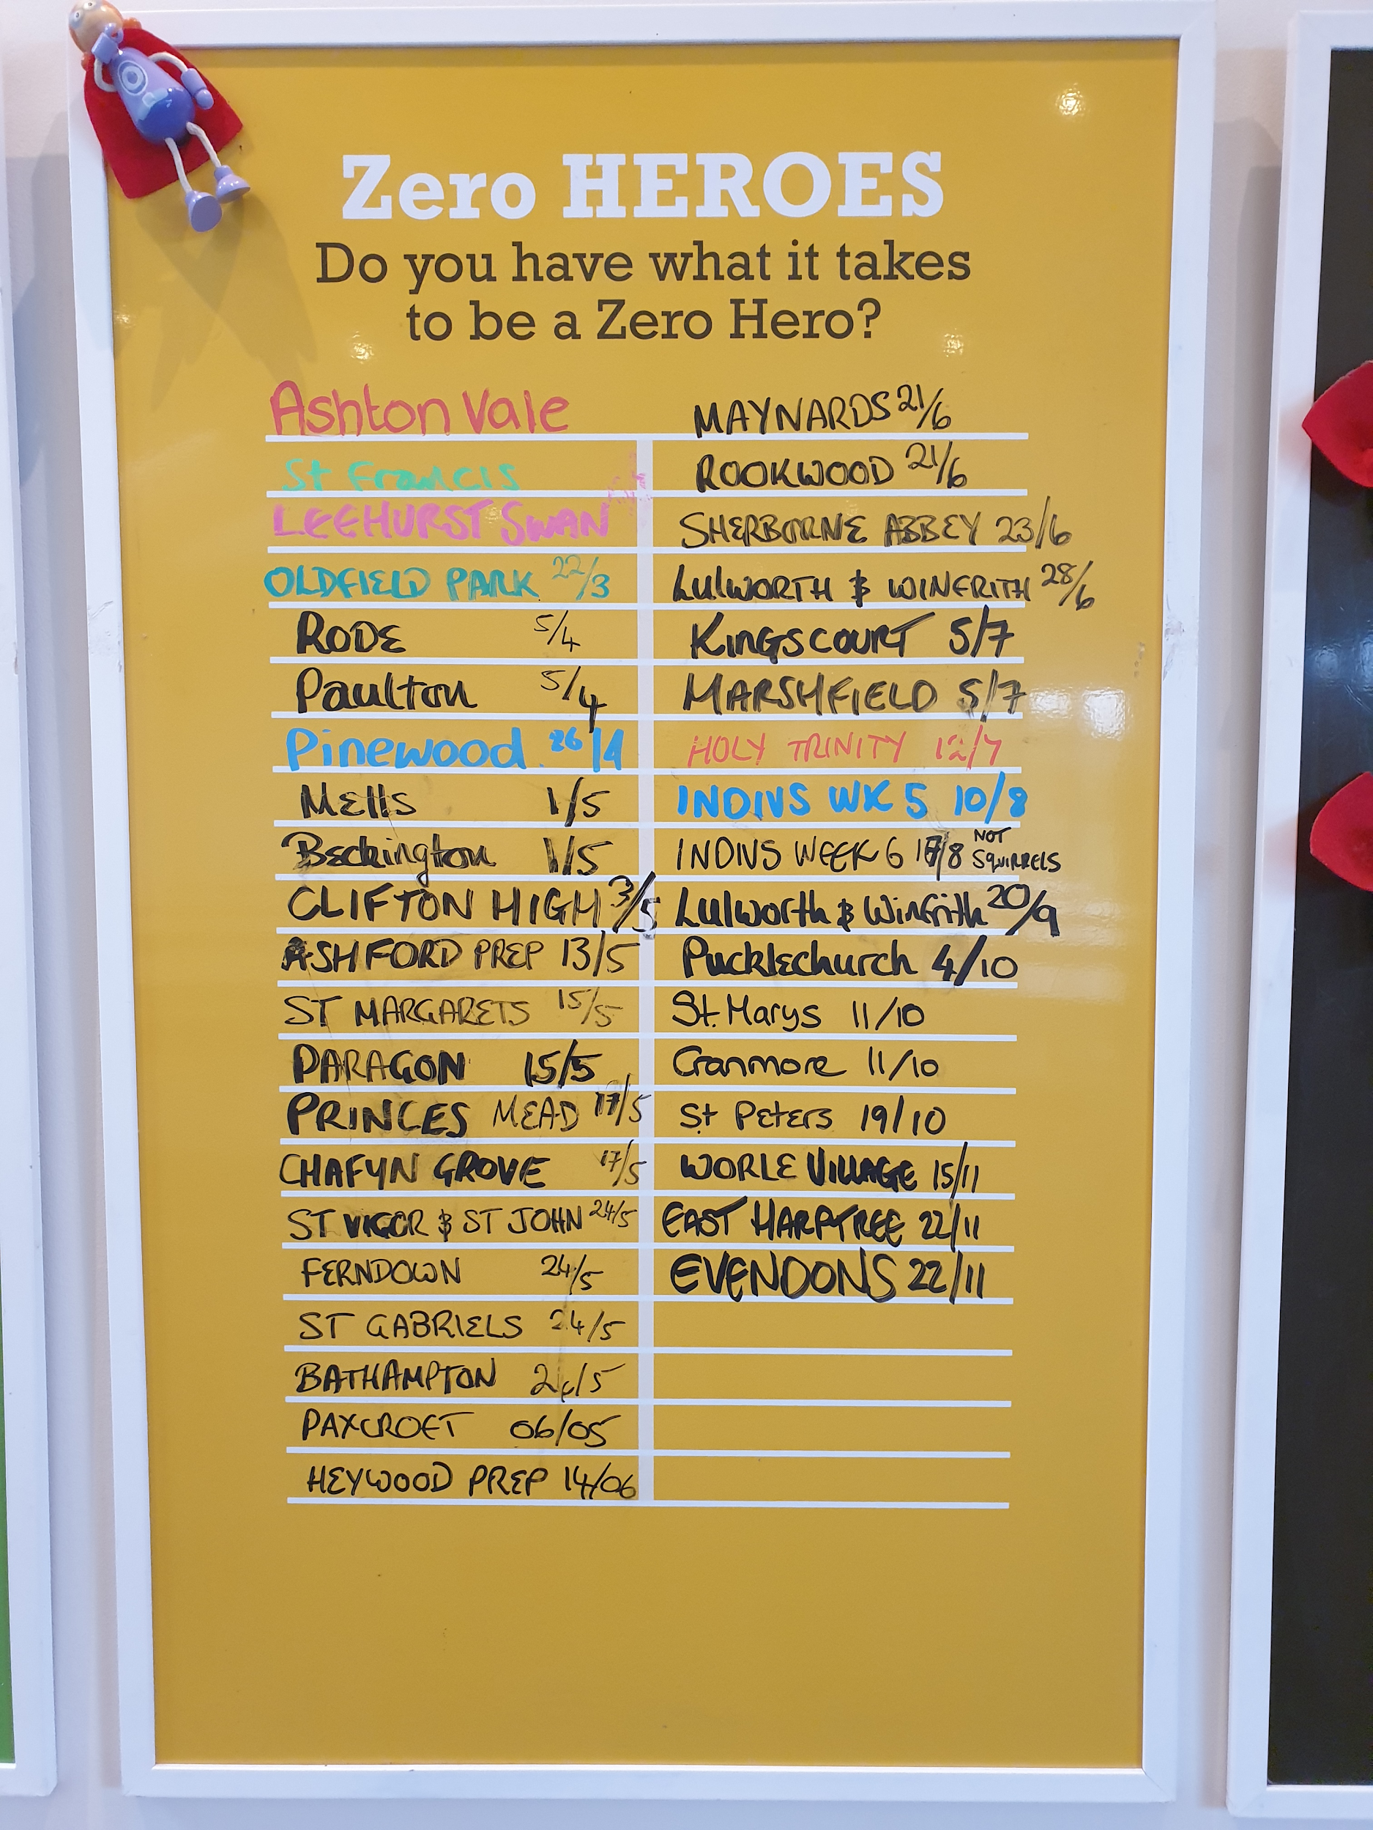
Year 3 Curriculum
Year 3 went to visit Mill on the Brue for our residential this year. At the centre they ran a zero hero competition - the aim was for the year group to go the entire three days without leaving any food waste.
We achieved the zero hero award which was a massive achievement!

Slide 19
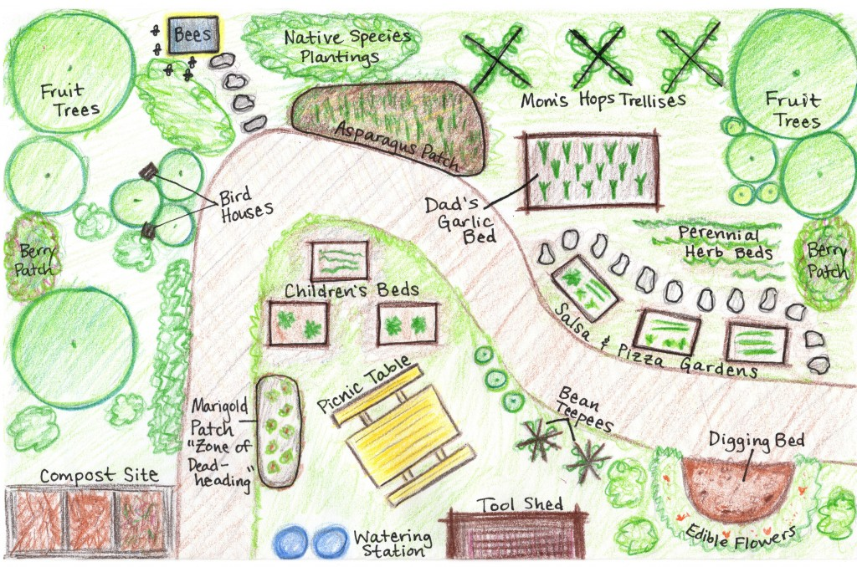
Year 4 Curriculum
SUSTAINABILITY
6 week topic
Created a sustainable shop
Knitting clothes/ weaving
Year 4 created a sustainable garden in their and maths lesson, children

Slide 20
Year 4 Curriculum
Sustainability center trip and sustainability topic
Our extraordinary challenge was to plant over 1,000 plants throughout the year.
This year we made a class pledge not to waste any food at lunch times.
Link to our extraordinary challenge:
https://docs.google.com/presentation/d/11jh_PZWt-PsfiYVoUkMC7i5J84AMoIhn8ceBEuEvLyk/edit#slide=id.p

Slide 21
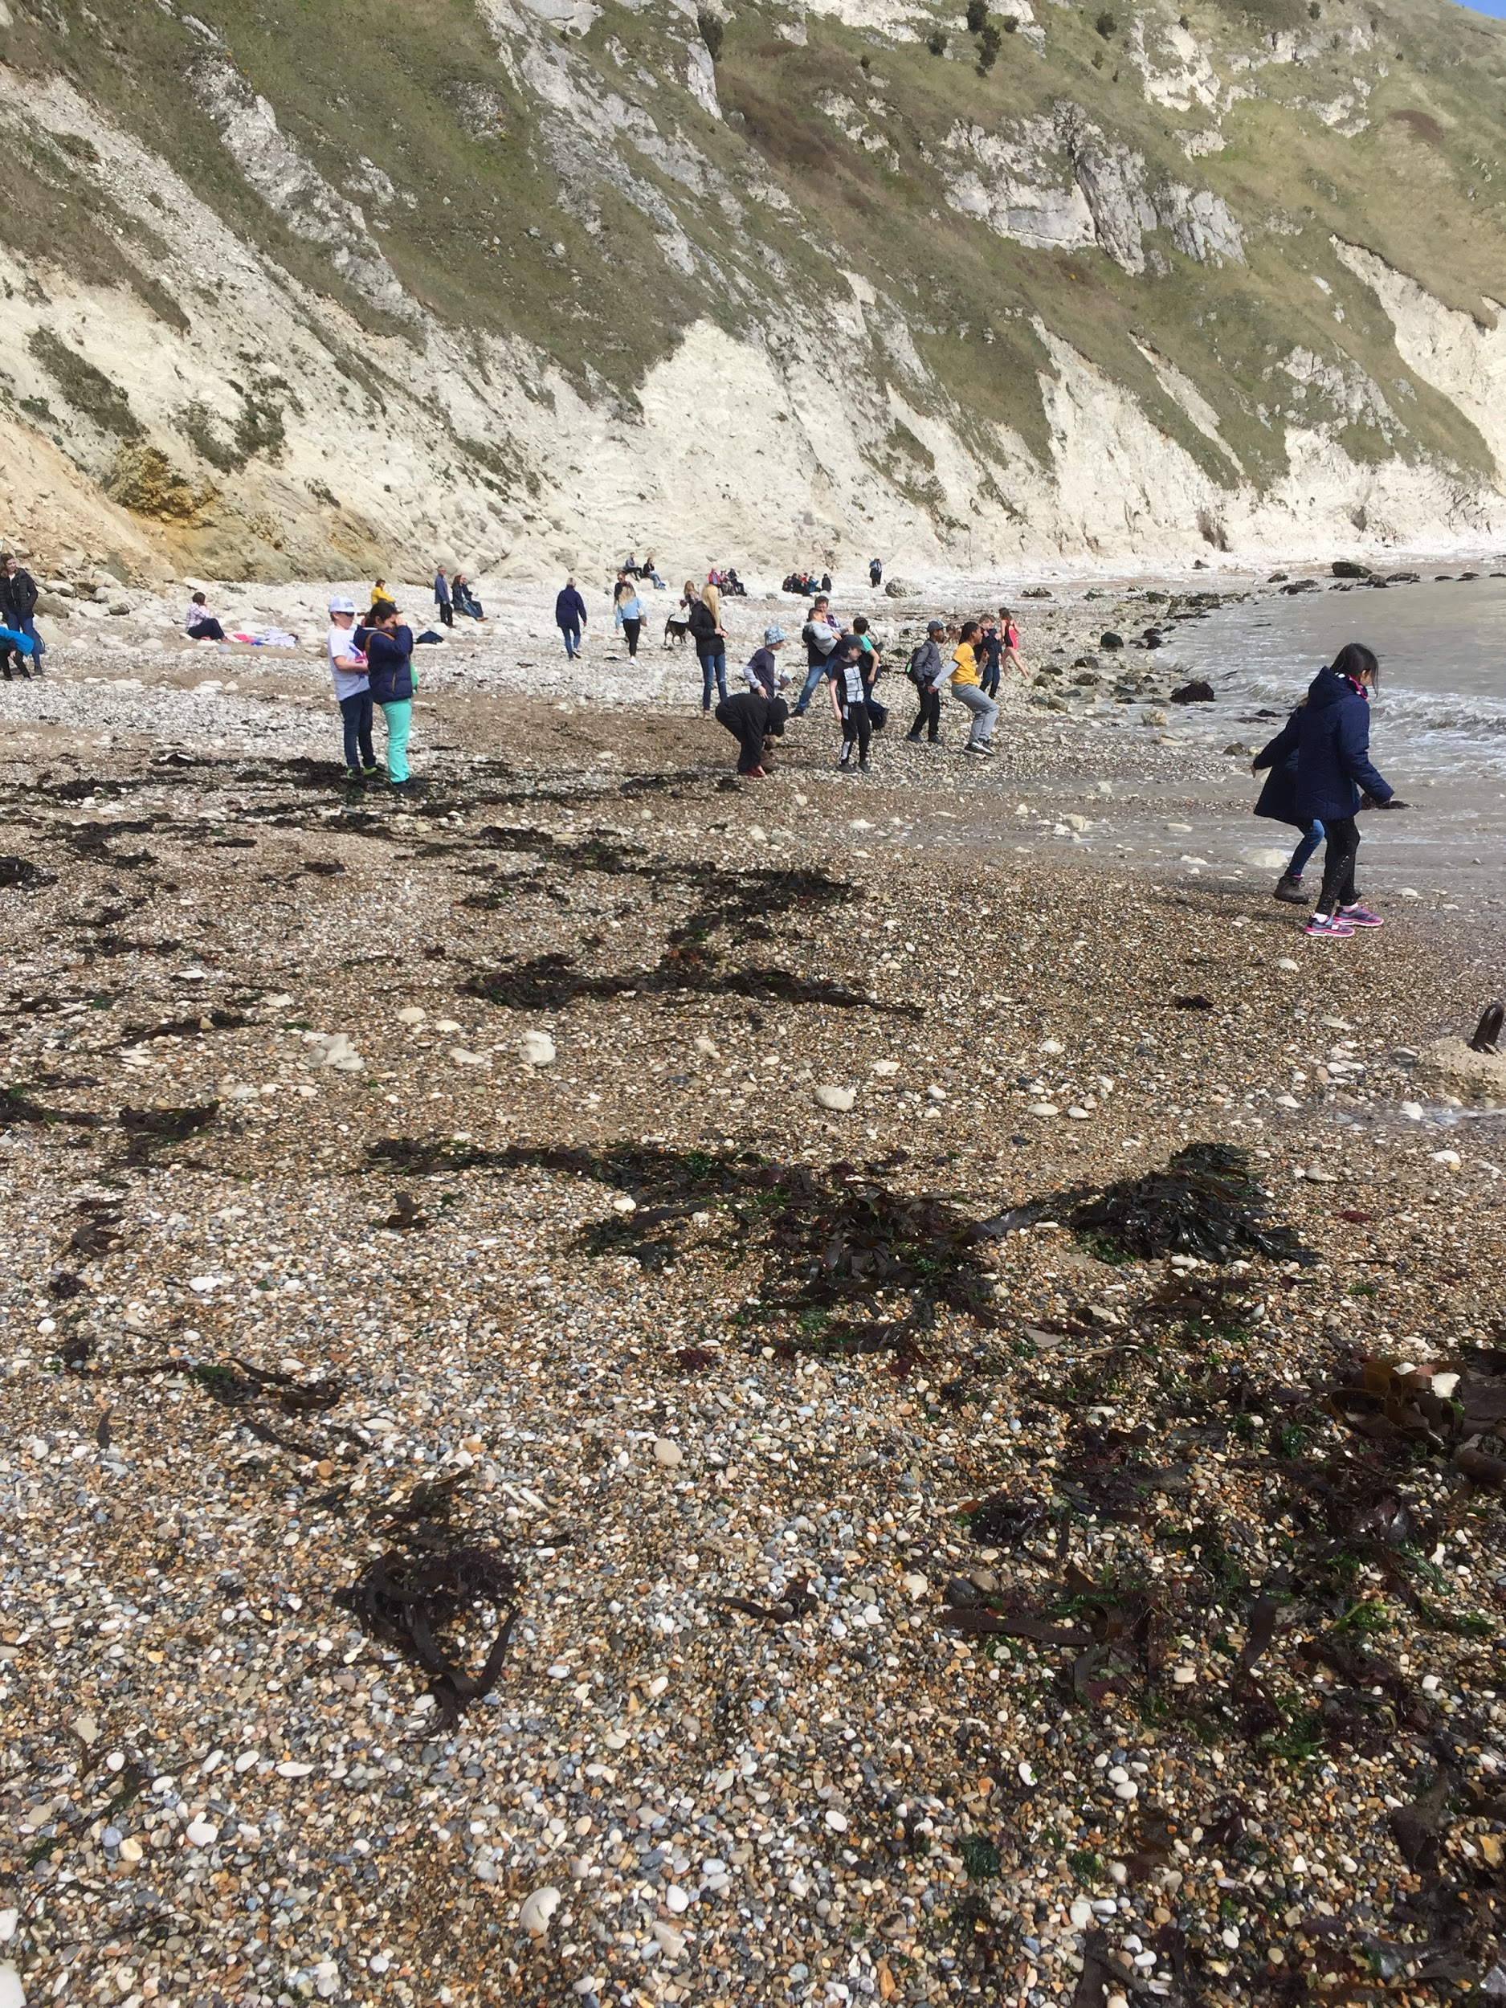
Year 5 Curriculum
Jane Goodall and the work of naturalists: Learning about how to study and care for the world. Includes a trip to Gilbert White’s house to learn how he studied animals and plants in their natural setting in the eighteenth century.
Natural disasters: Studying a range of natural disasters, the causes and impacts.
Coasts: A geography study of coastal erosion and deposition. Looking at the effects of climate change and how this has affected severe weather events. Part of this trip takes place during the residential at Hooke Court.

Slide 22
How sustainability has impacted the views of individuals at Evendons
Freddie and Tegwyn (Year 2) decided to lead a whole school assembly about plastic pollution. They brought in plastic from home to illustrate wasteful packaging and reminded the school of top tips for reducing waste and provided information about how this was damaging to the planet.
Toby Jordaan (Year 1) led a whole school assembly about the use of Palm Oil and how it is affecting orangutans.
Eden set up a challenge and collecting point for milk bottle tops.
Chloe, Iris and Lily (Year 2) did an assembly to Years 2 and 3 about litter and how to help prevent litter in and around school.

